Slide 1
Cancellation of hotel bookings using ml algorithm
Jagadeesh seepana
119ec0030

Slide 2
Outline :
Problem Statement
Given Data
Visualization
Steps Involved
Model Chosen
Conclusion

Slide 3
Problem statement:
Hotel booking cancellation predicting with binary classification is a problem based on data analysis techniques which gives an idea to create best classification model.
With given a data set containing the details of applicants for hotel booking and status of their booking application approval whether approved or not . By using above details we need to create an binary classification model with maximum a

Slide 4
Given data:
Number of hotel bookings cancelled(Data Set)
Data types
https://raw.githubusercontent.com/Premalatha-success/Datasets/main/hotel_bookings.csv

Slide 5
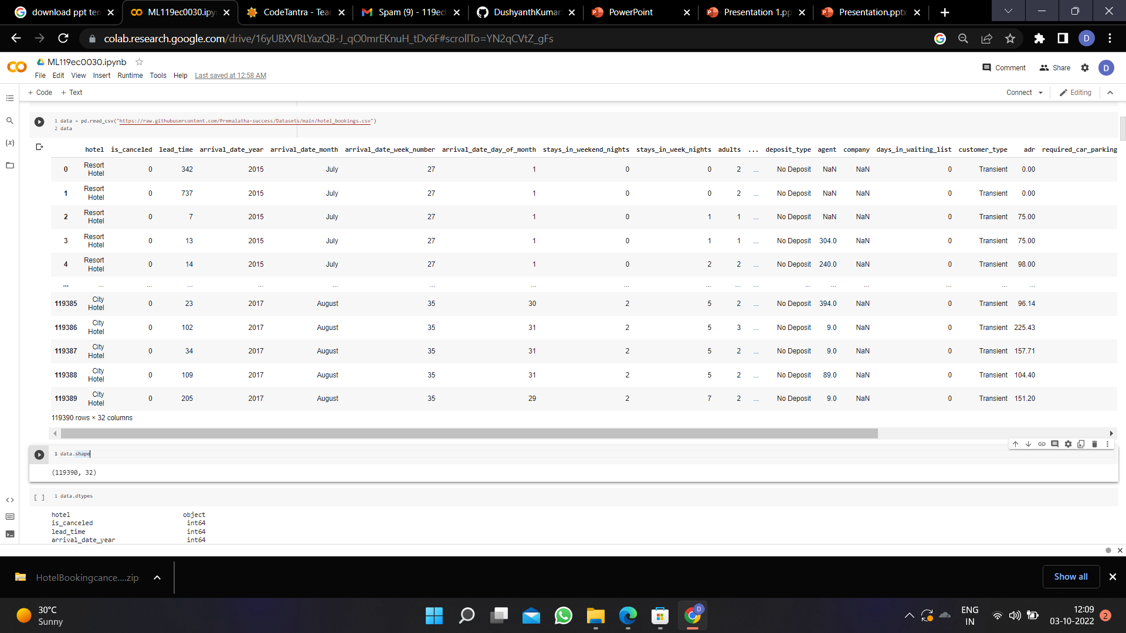
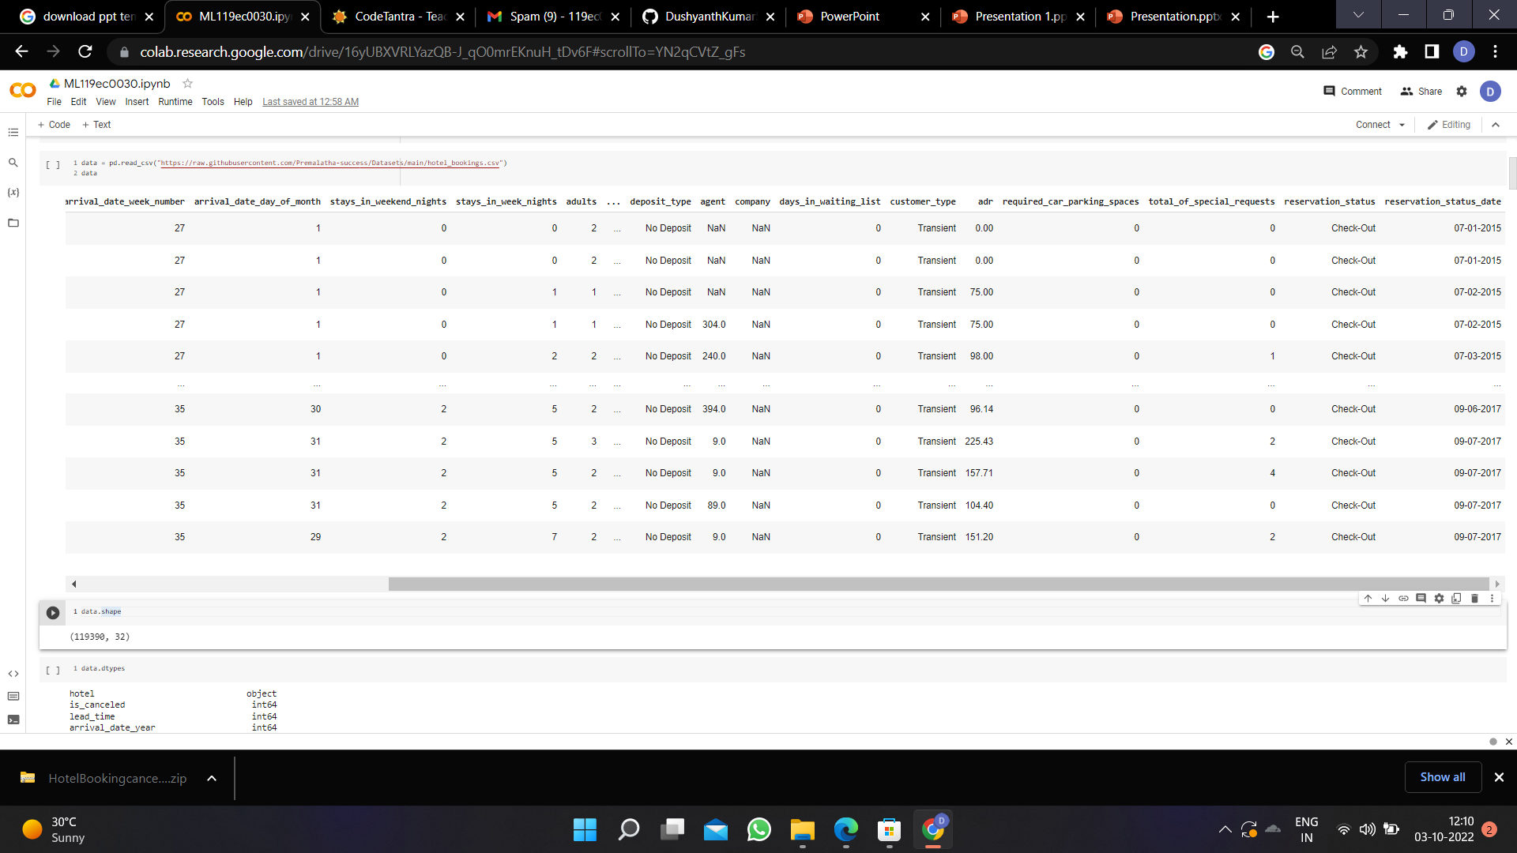
DAta Set:

Slide 6
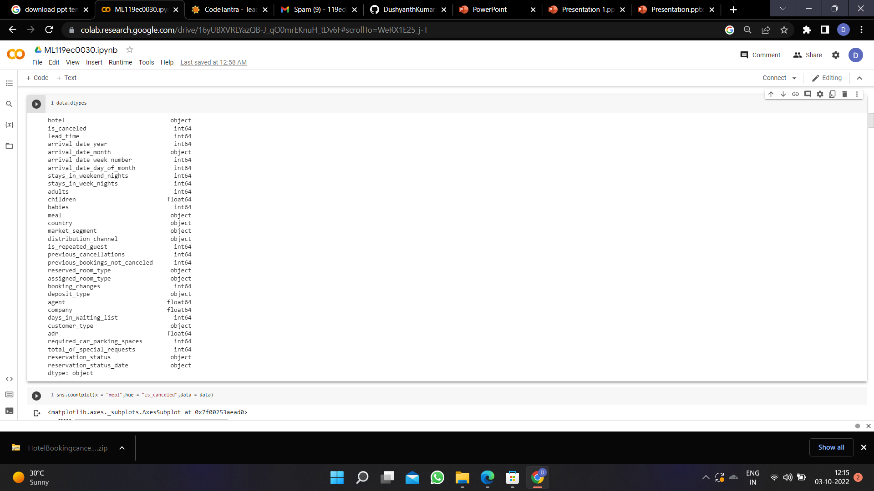
Data type:

Slide 7
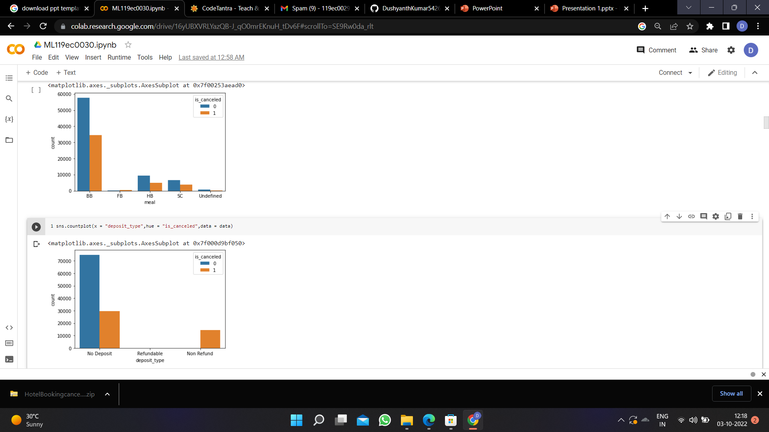
Visualizing feature to feature:

Slide 8
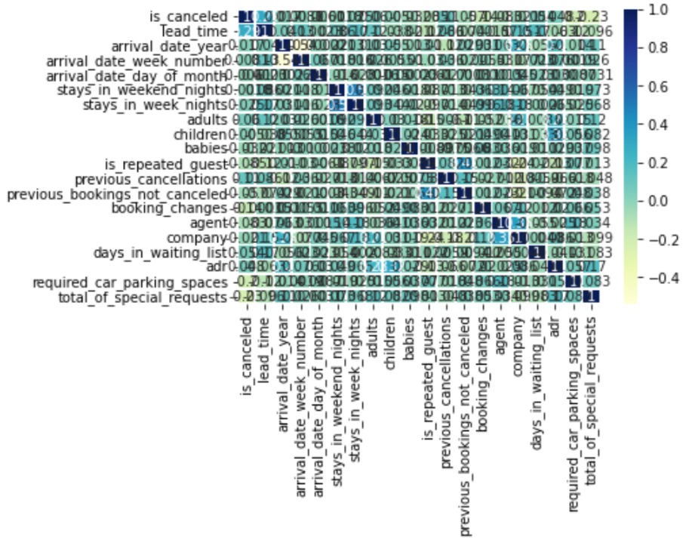
Heatmap of correlation :

Slide 9
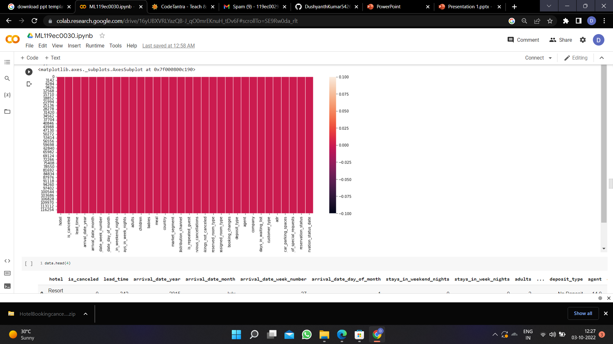
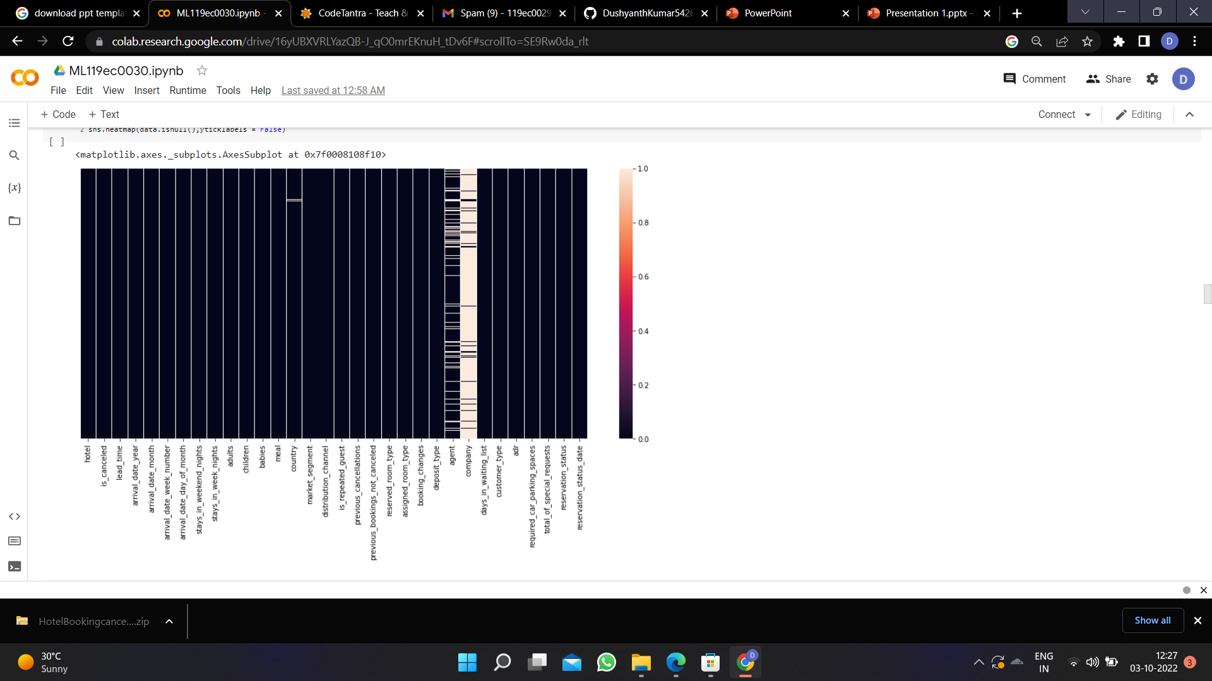
Visualization of null values:

Slide 10
Steps involved:
1 - Import the packages numpy,pandas,matplotlib,seaborn,sklearn,train test split,metrics
2 - Load the Dataset
3 - Explore the data-shape,visualization
4 - X,y-->train data test data->Fit the model with training data predict with the test data

Slide 11
Model chosen:
I have chosen bagging as i had done with other models like KNN,SVM,Decision tree,Random forest.. but i got 100% accuracy rate at Bagging.
Bagging (or Bootstrap Aggregating) technique uses these subsets (bags) to get a fair idea of the distribution (complete set). The size of subsets created for bagging may be less than the original set

Slide 12
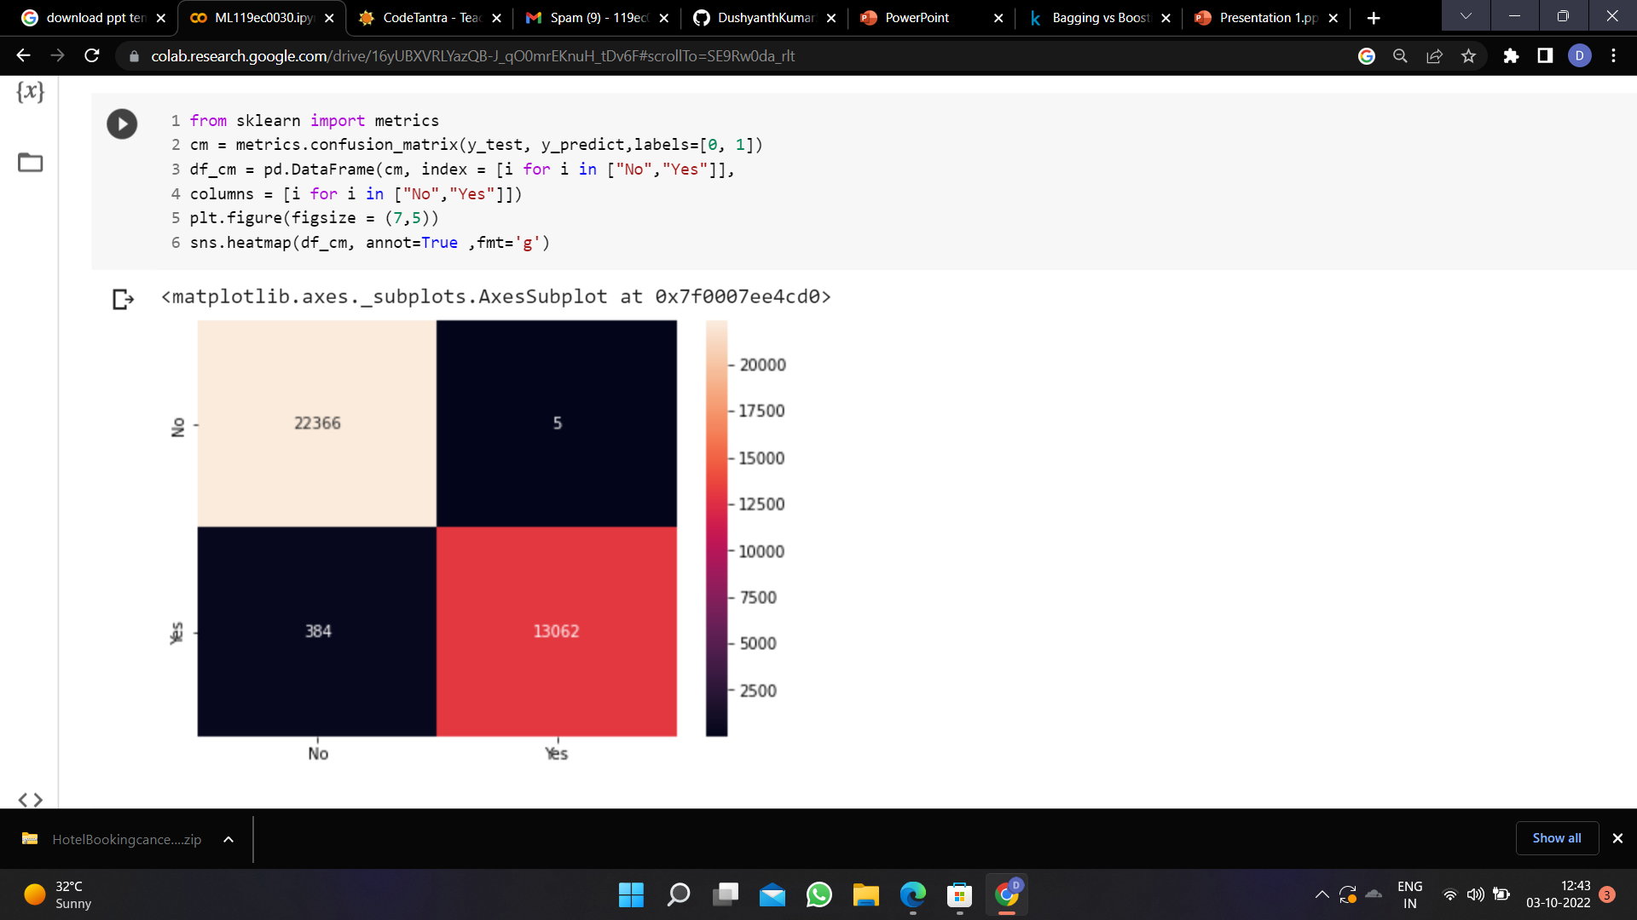
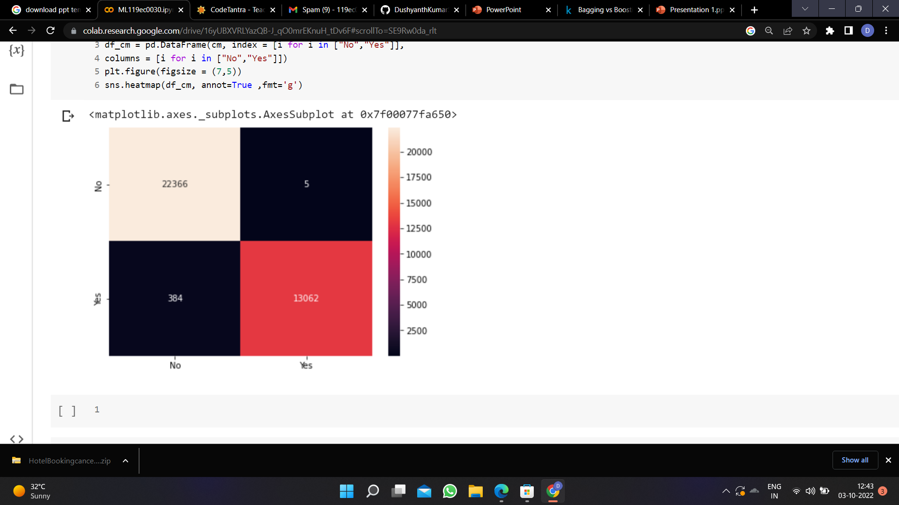
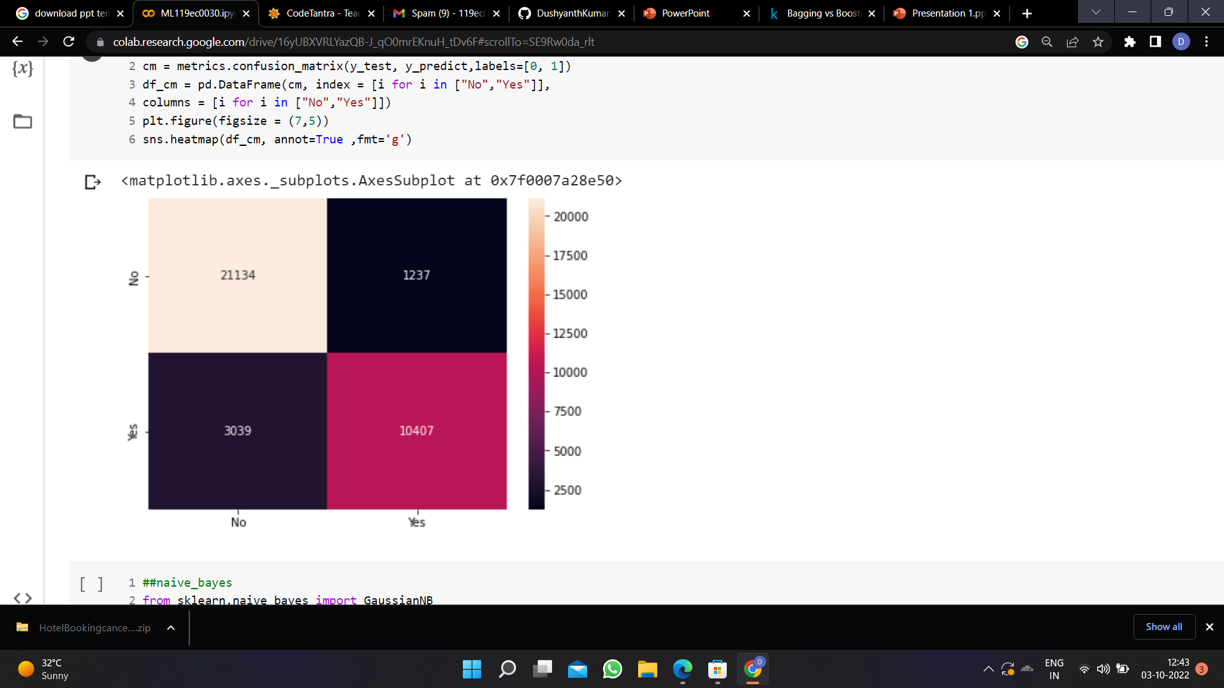
Confusion matrix:
Logistic Regression
KNN
SVM

Slide 13
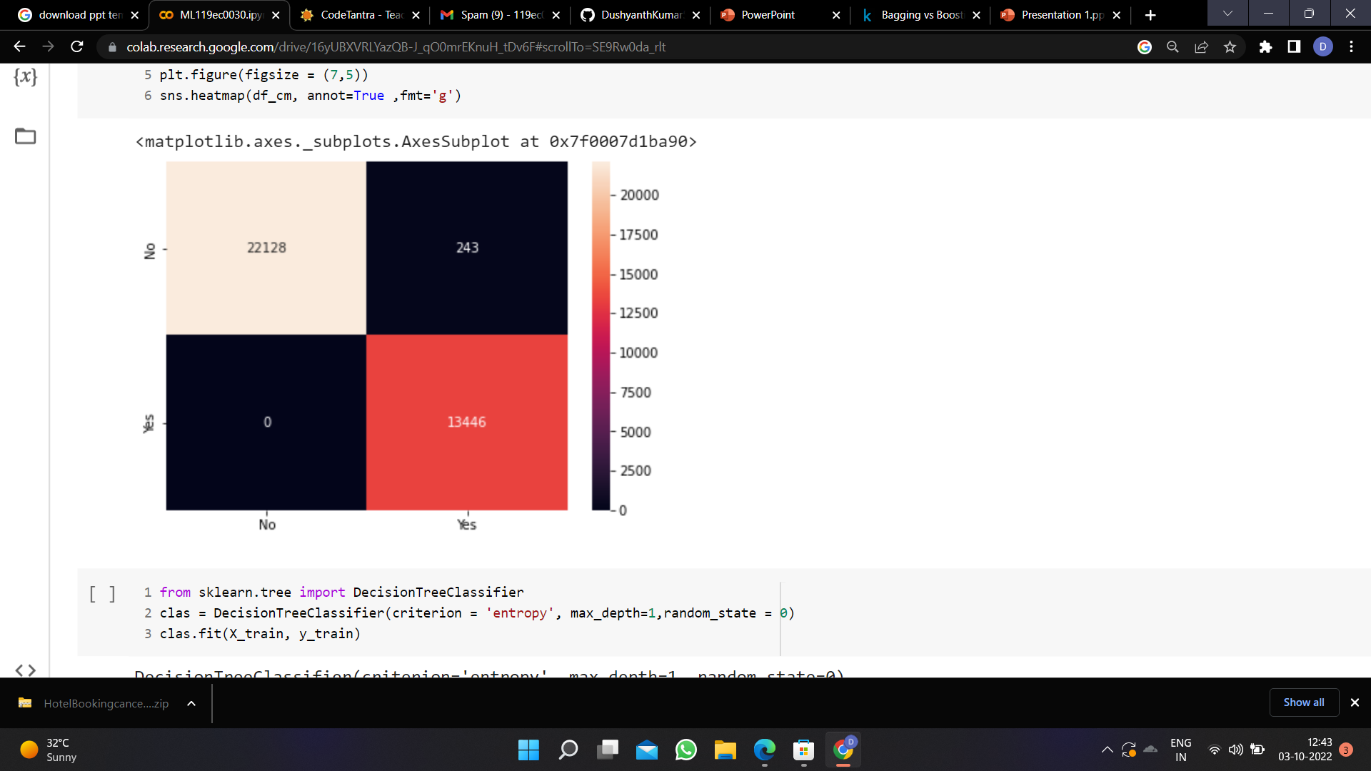
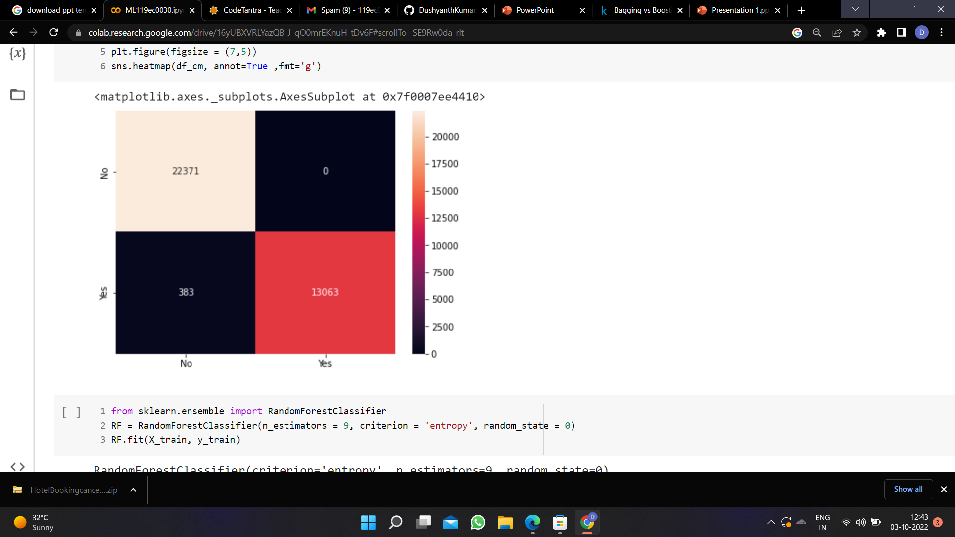

Confusion matrix:
Naive's bayes Decision tree Random forest

Slide 14
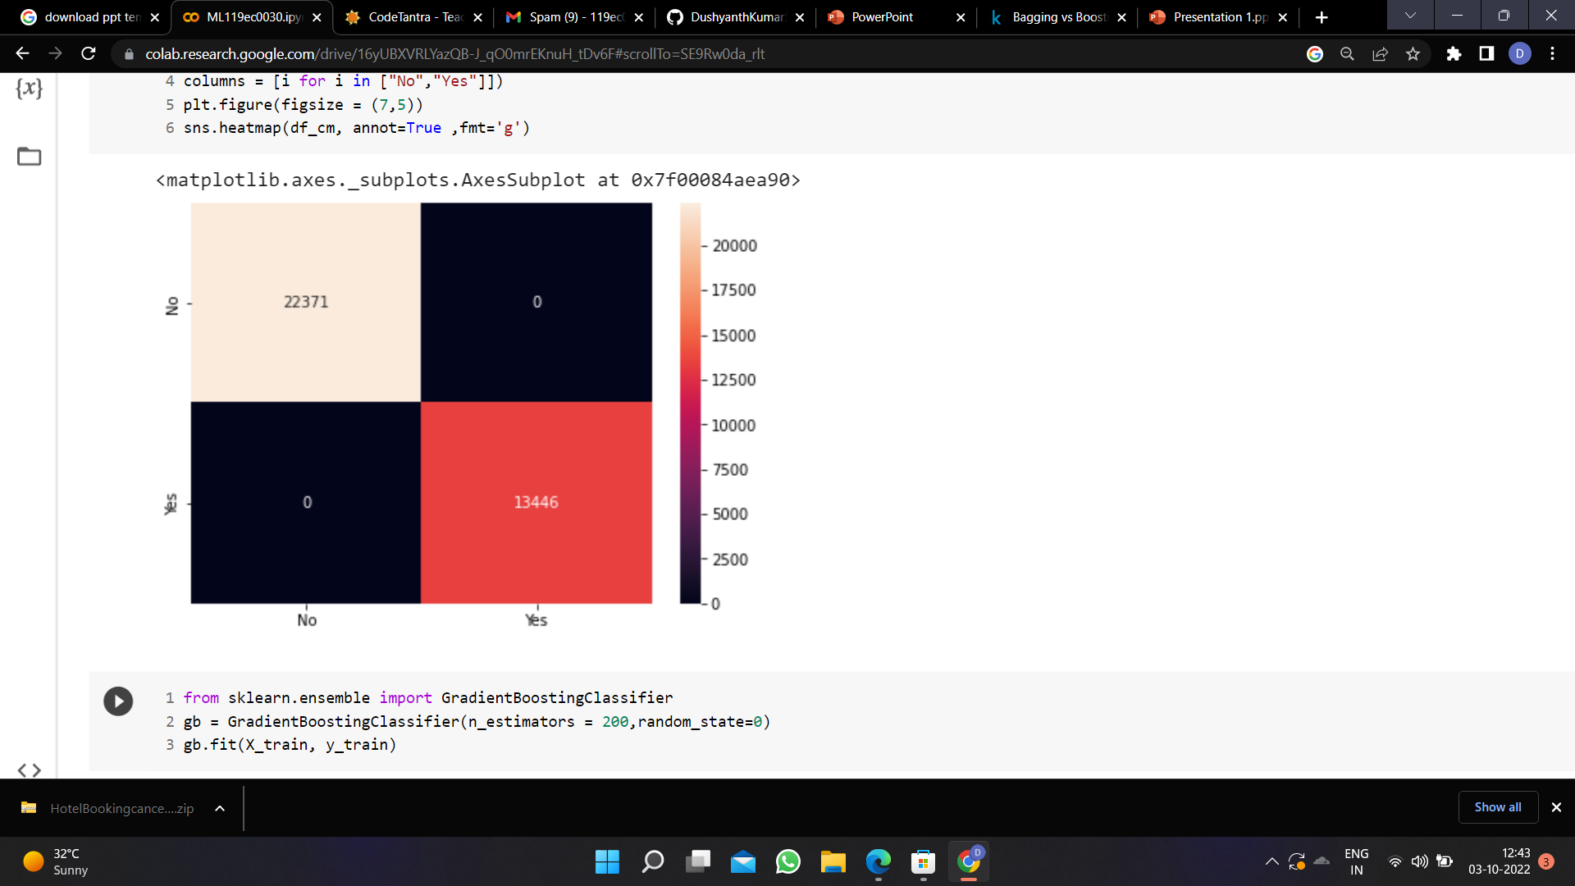
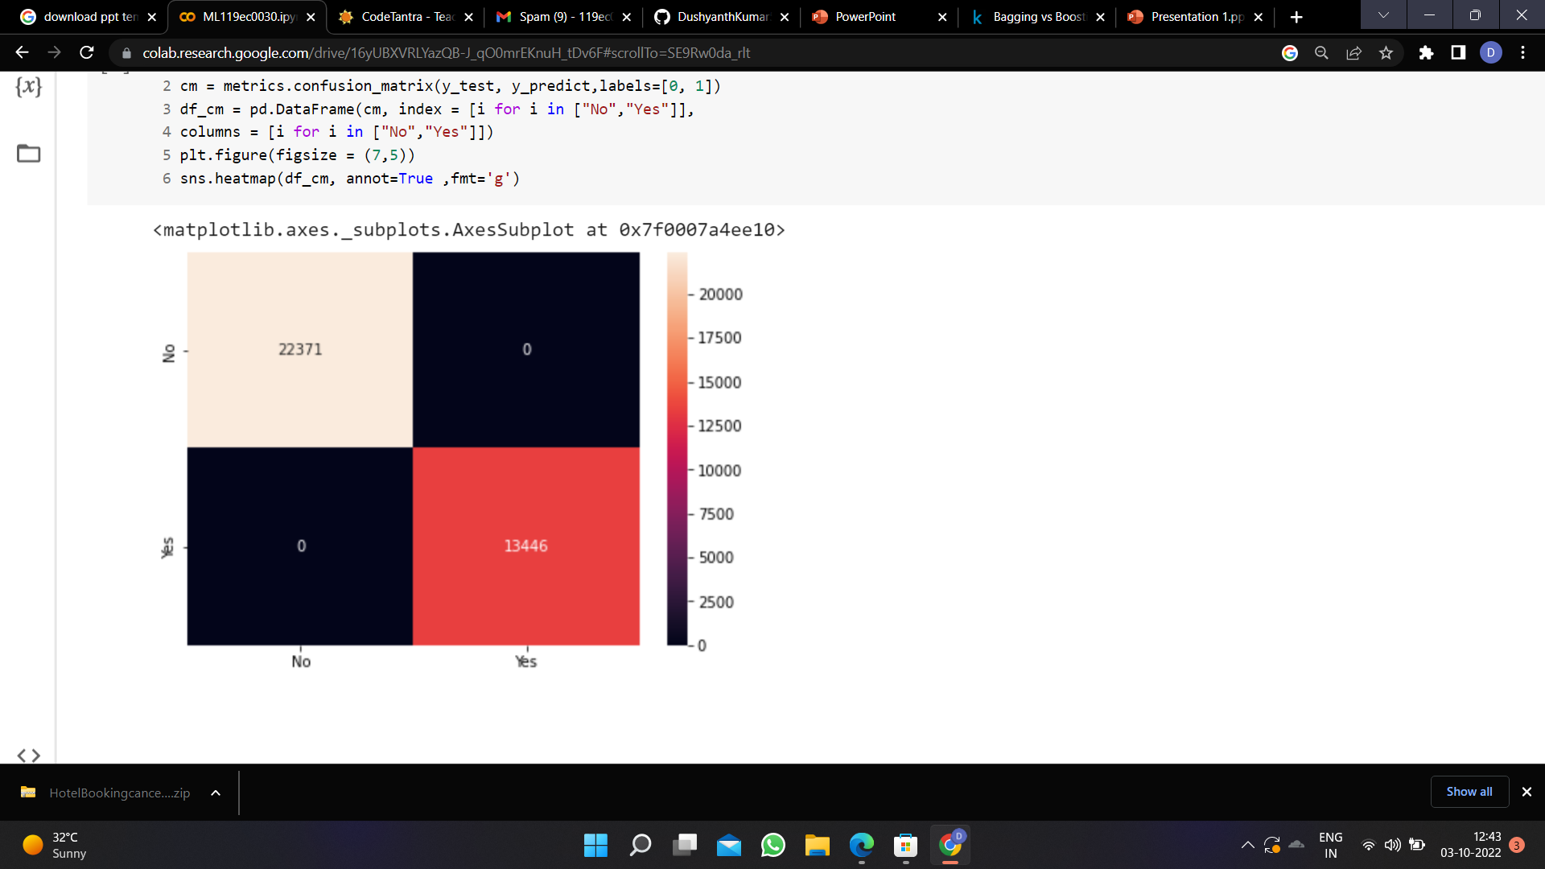
Confusion matrix:
Bagging Boosting

Slide 15
Conclusion:
We have used 8 ml algorithms to solve the given problem. From that we have concluded that bagging is more accurate for this problem.
The accuracy rate and precision rate for the models are as folows :
Logistic regression:
1.Training set : 0.9899967692915176
2.Testing set : 0.9891392355585337
SVM:
1.Training set : 0.7187967405741089
2.Testing set : 0.7152469497724544
KNN:
1.Training set : 0.9193639093965754
2.Testing set : 0.8806153502526733

Slide 16
Conclusion :
Naive's bayes:
1.Training set : 0.9928565445777943
2.Testing set : 0.9932155121869504
Decision Tree:
1.Training set : 0.99014035633518
2.Testing set : 0.9893067537761399
Random Forest:
1.Training set : 1.0
2.Testing set :0.9993857665354441
Bagging:
1.Training set : 1.0
2.Testing set : 1.0

Slide 17
Thank you
-Jagadeesh Seepana
119ec0030

